Slide 1
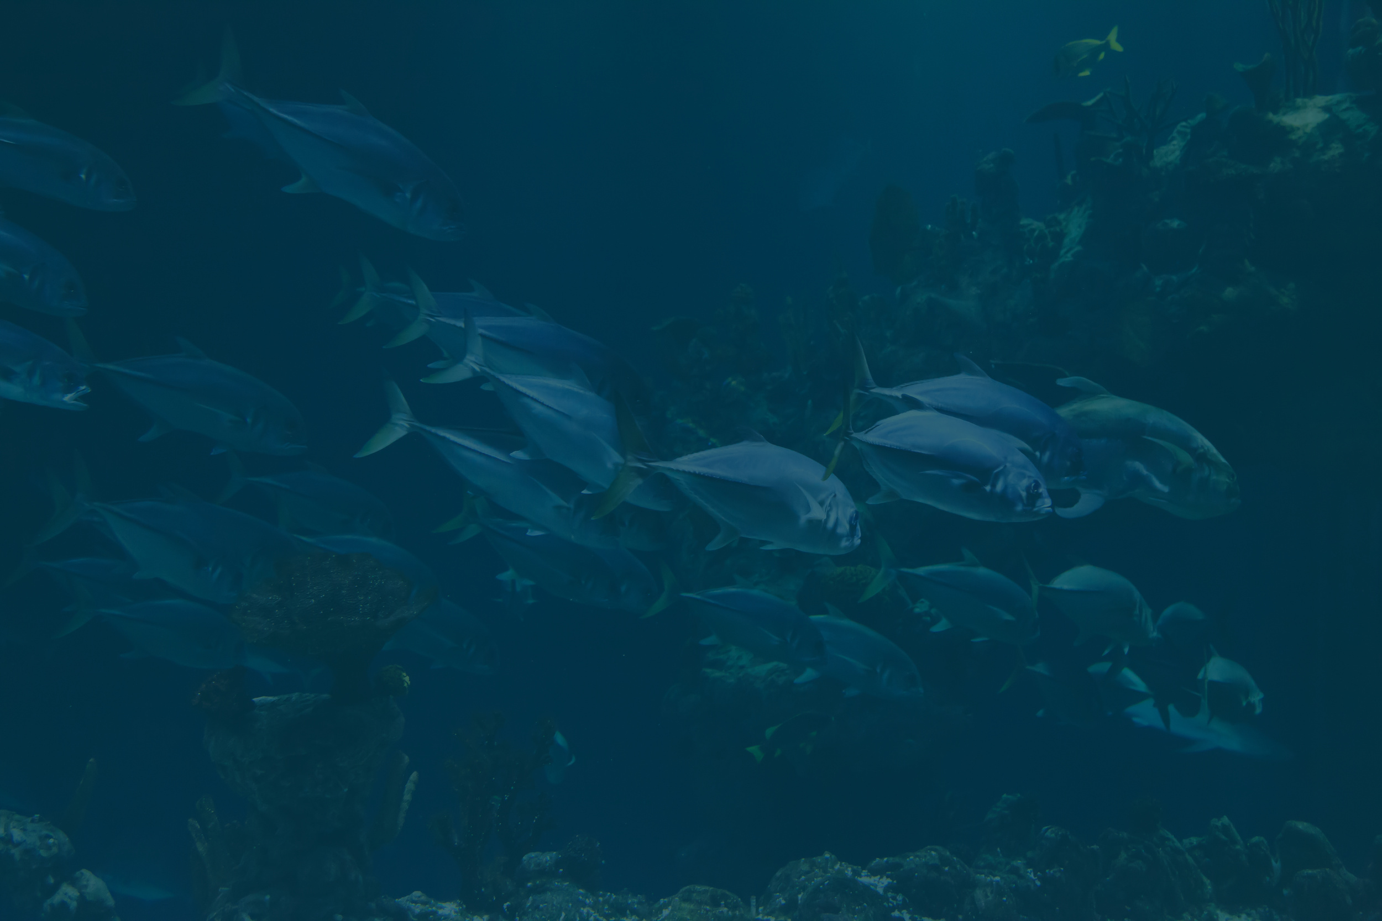

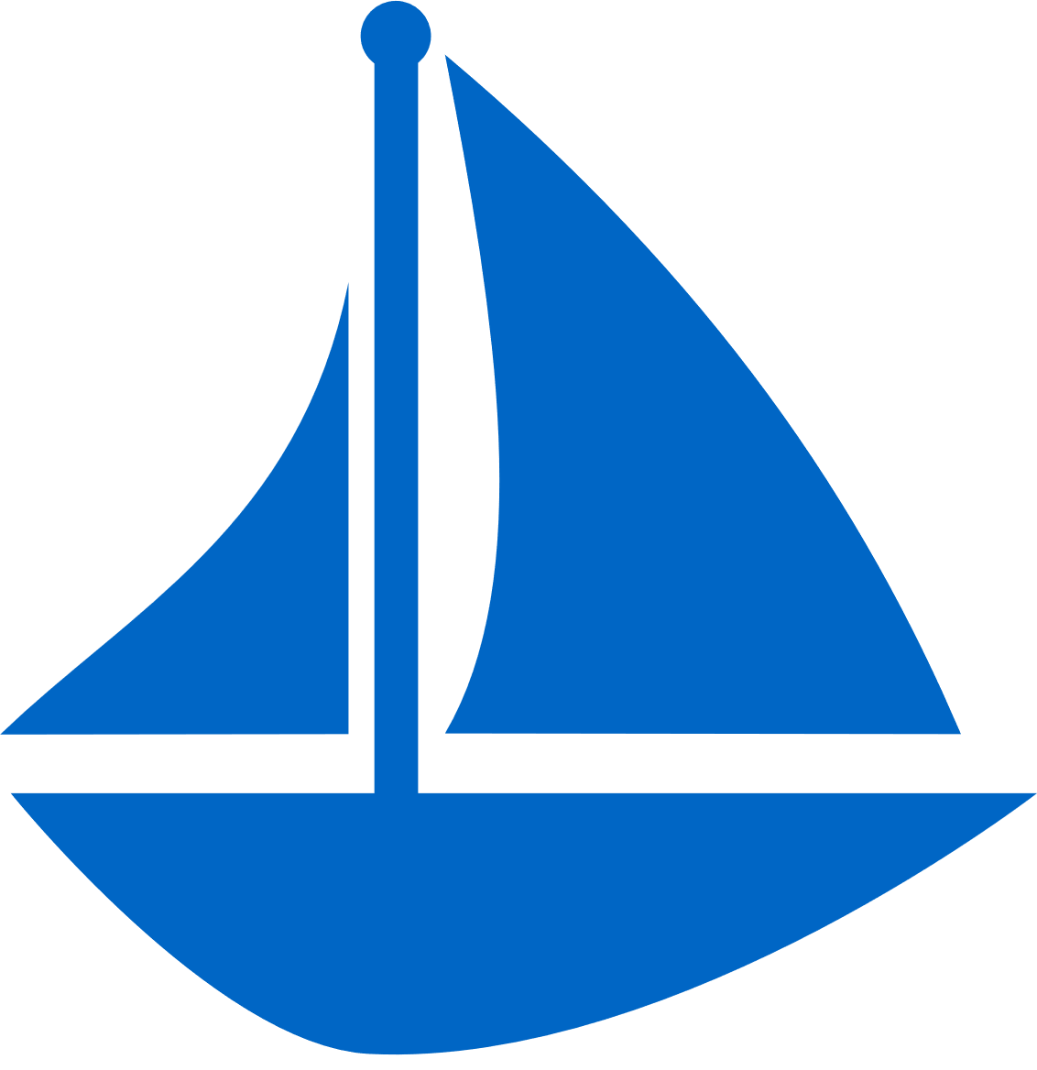

AGENTIC HACKATHON
Problem Statement - Fishermen rely on guesswork, wasting fuel and time with unpredictable catches. They need a smart digital tool that analyzes past data to deliver real-time, zone- specific fishing routes for maximum efficiency and profit.
Get Started
Name of the Team - QuadX
Team Members - Ayesha Siddiqa K Divya Sree R
Arulmoli R Ani M

Slide 2
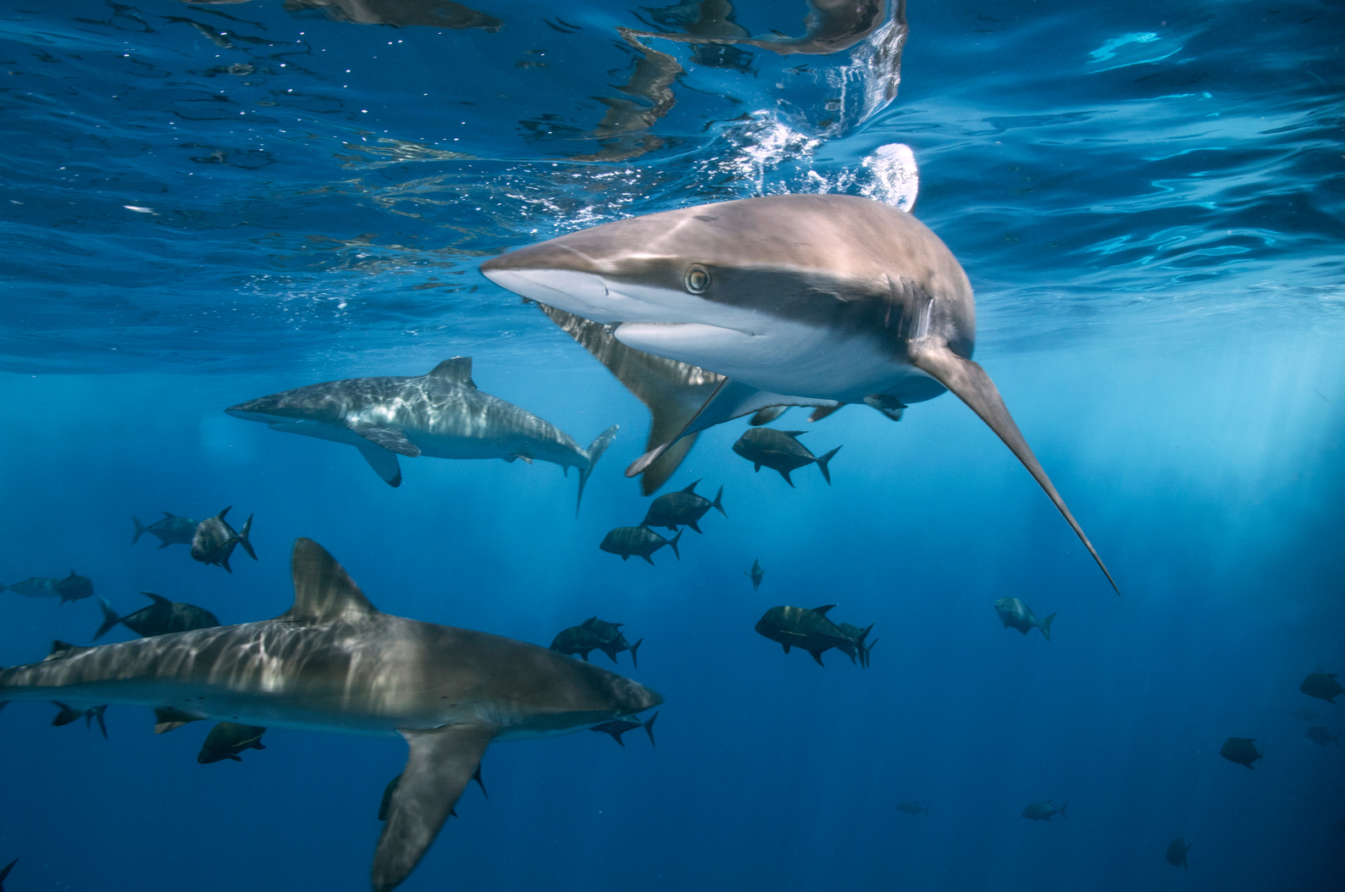
SOLUTION
We propose 'TrawlSmart AI' – a smart fishing route optimization tool designed for the Indian coastline. It combines historical catch data, sea zone mapping, and smart route logic to suggest the best fishing areas. The tool provides offline-first access, local language support and an easy-to-use visual map interface.

Slide 3

TECH STACK
Languages & Data
HTML5, CSS3, JavaScript (ES6)
JSON, GeoJSON (for zones & records)
Libraries & Frameworks
Leaflet.js – Interactive Map & Marine Routes
Bootstrap 5 – UI Components & Responsiveness
Bootstrap Icons – Visual Icons
ResponsiveVoice.js (Optional) – Voice & Language Support
APIs & Services
OpenWeatherMap API – Real-Time Weather & Wind Layers
NASA GIBS WMS (NOAA SST) – Sea Surface Temperature Overlay
IMD RSS Alerts – Official Indian Weather Warnings
Browser Geolocation API – Fishermen Location Tracking
Tools & Deployment
Firebase Hosting / GitHub Pages
Visual Studio Code, Chrome DevTools
Learn More

Slide 4
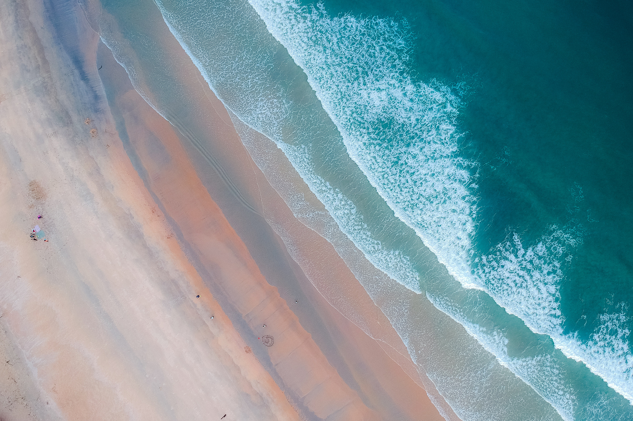
BUISNESS ANALYTICS
Real-Life Scenario:
A coastal fisherman, uses TrawlSmart AI to:
Get Smart Fishing Routes → Saves fuel & time
Log Daily Catches → Learns from past catch patterns
Receive Weather Alerts → Avoids risky sea conditions
Market Potential:
4M+ Indian Fishermen
Expandable to South Asia & Coastal NGOs
Scalability:
Add more zones, features, and AI predictions
Offline-first design with local language support
Runs on mobile, tablet, or onboard boat devices

Slide 5
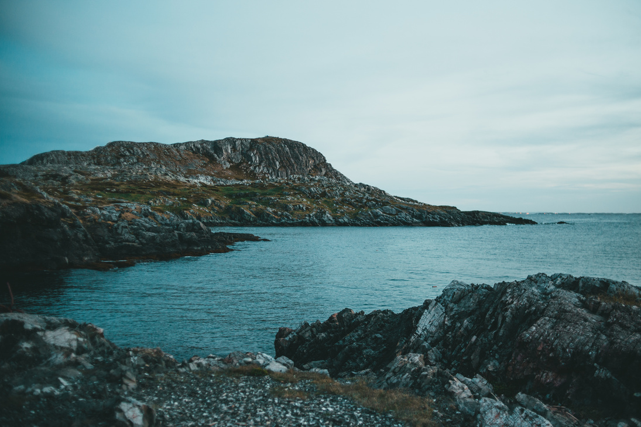
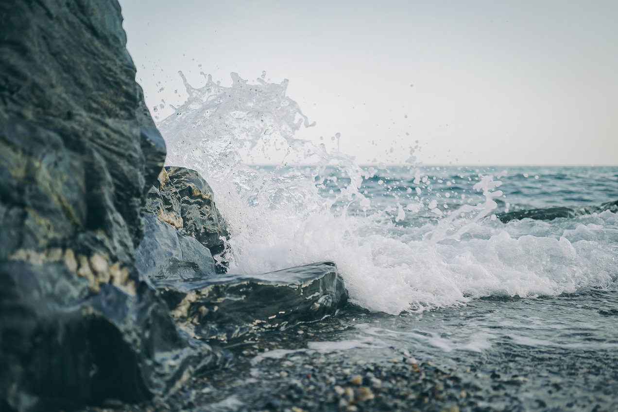
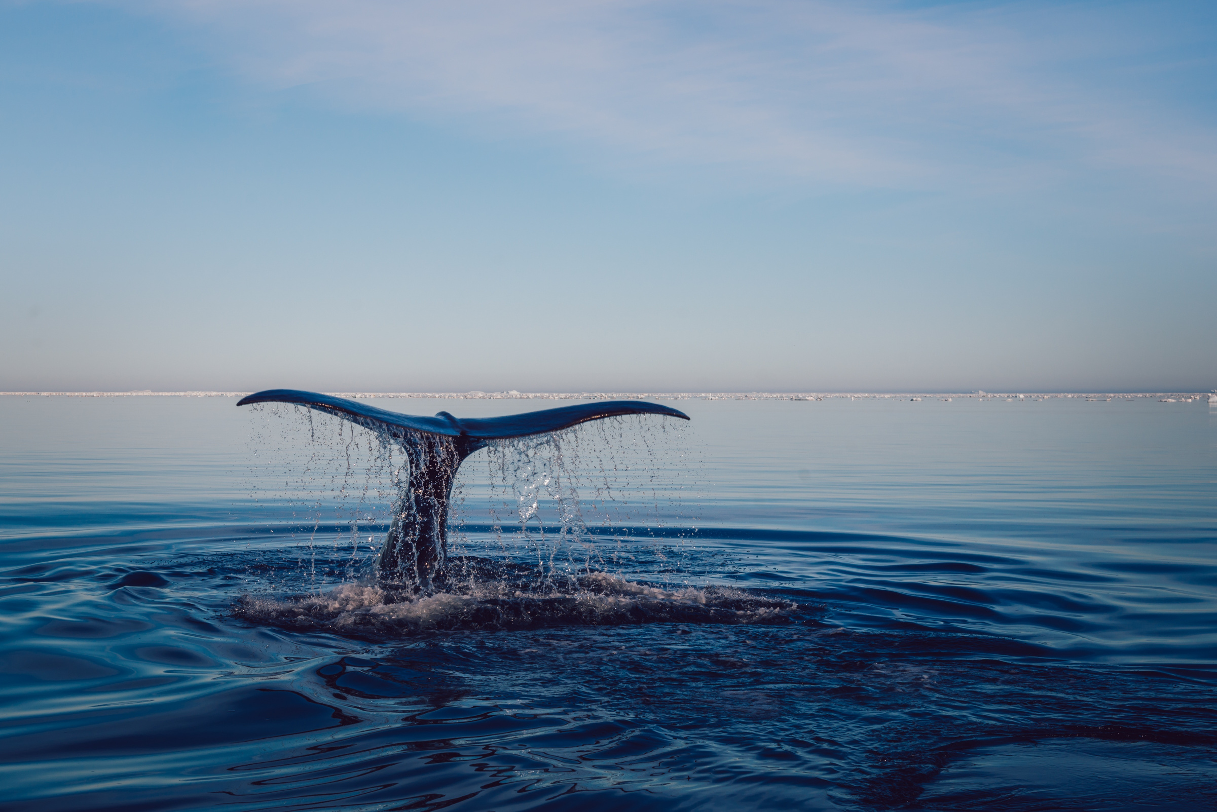
TrawlSmart AI Youtube Link :
https://youtu.be/3sLfHyApGxU?feature=shared

Slide 6
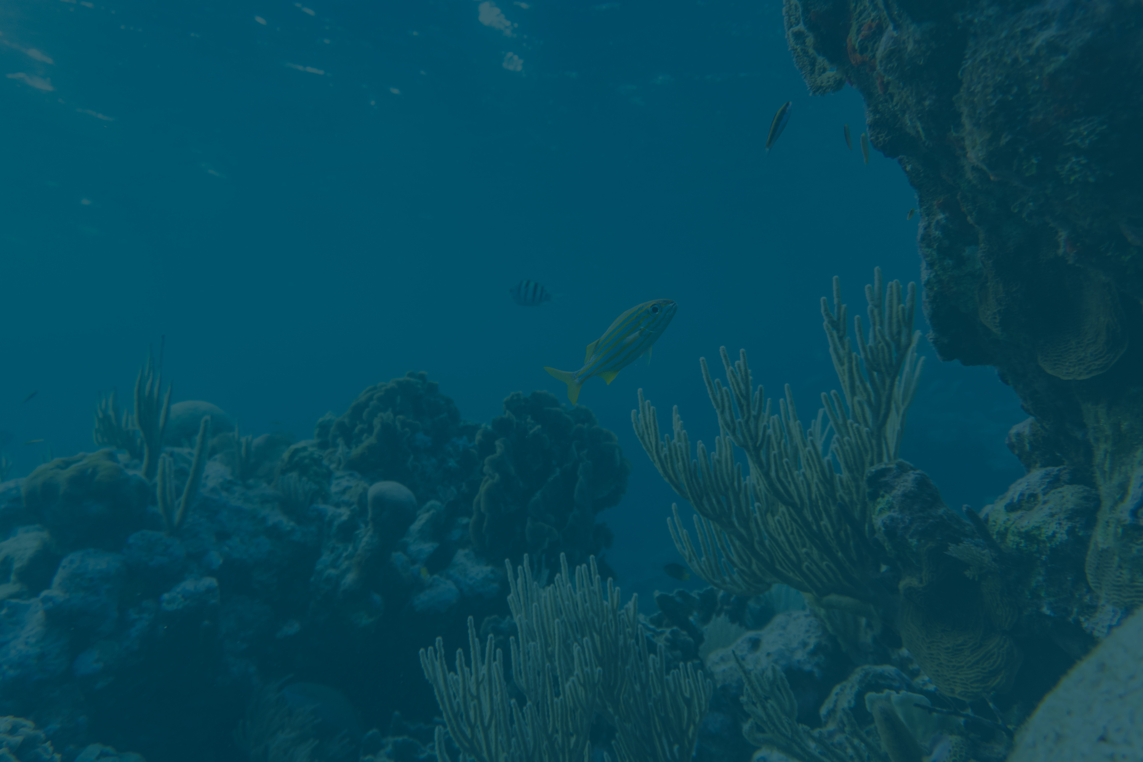
THANK YOU

